Slide 1

Separating DNA Mixtures by Computer to Identify and Convict a Serial Rapist
American Academy of Forensic Sciences
February, 2016
Las Vegas, NV
Mark W Perlin, PhD, MD, PhD
Cybergenetics, Pittsburgh, PA
Garett Sugimoto, MS
Kern Regional Crime Laboratory, Bakersfield, CA
Cybergenetics © 2003-2016

Slide 2
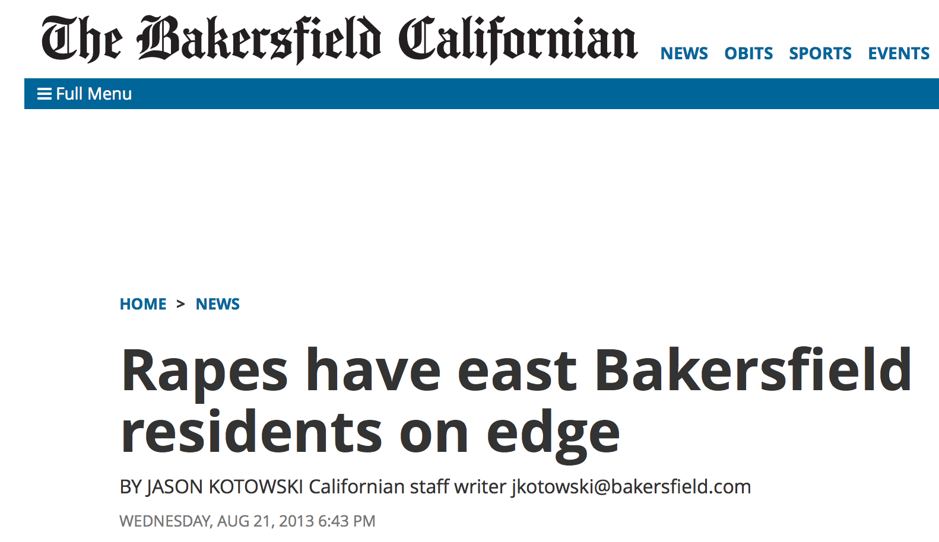
July & August 2013

Slide 3
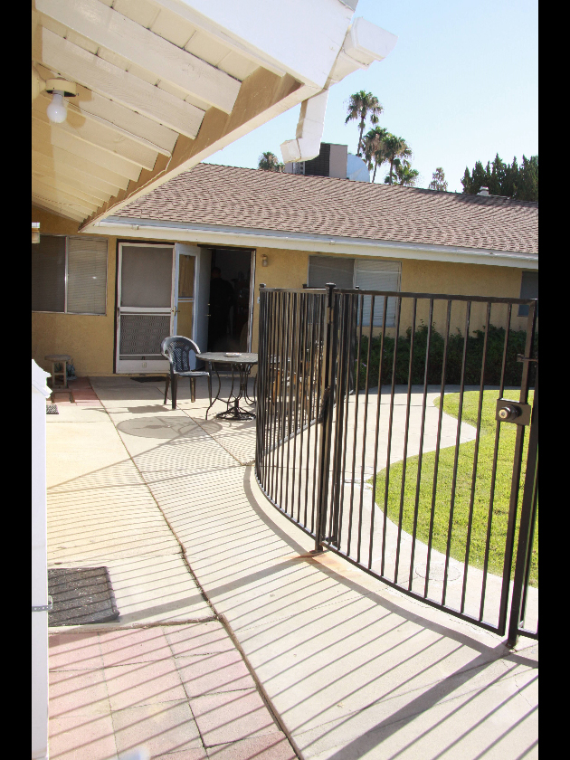
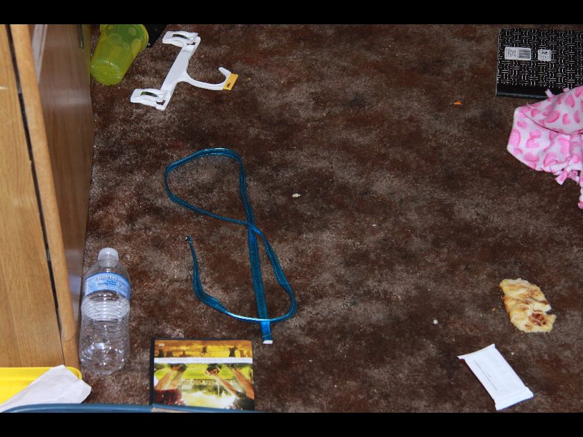
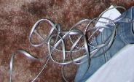
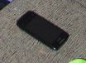
Crime scene #1
Purse strap
Phone cord
Phone

Slide 4
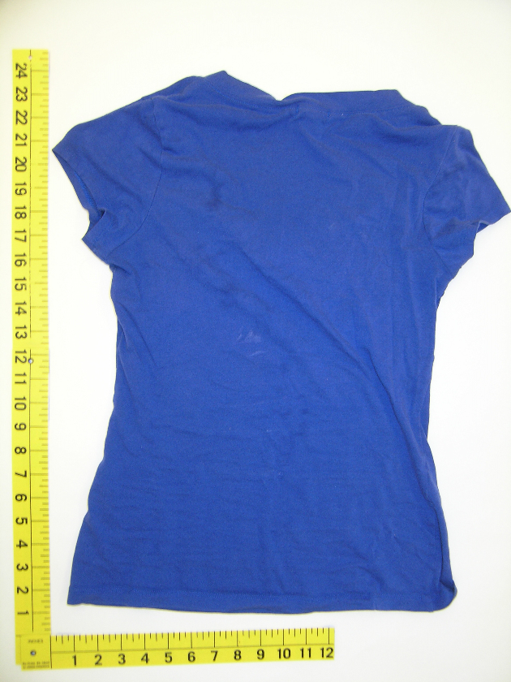
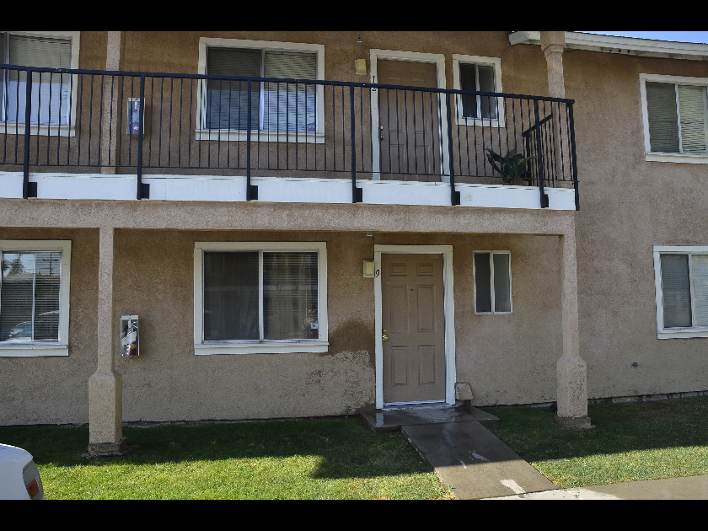
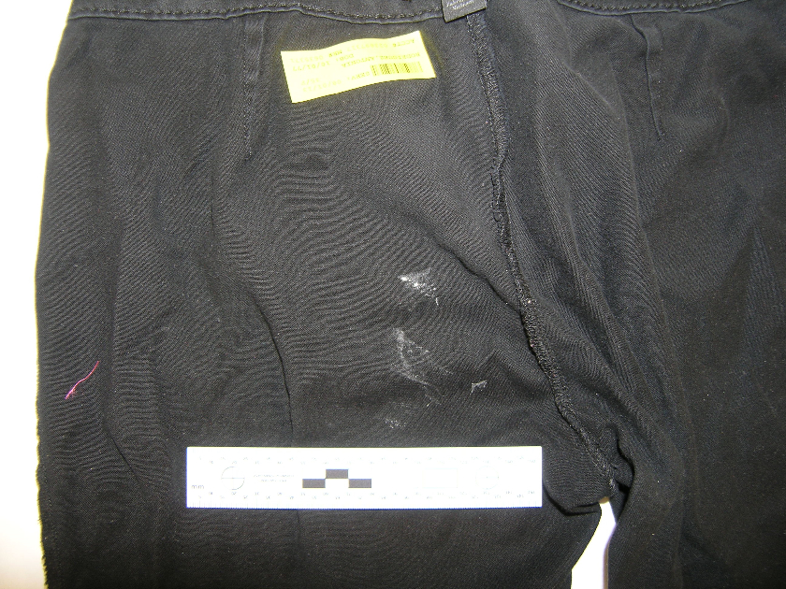
Crime scene #2
Shirt
stain
Pants

Slide 5
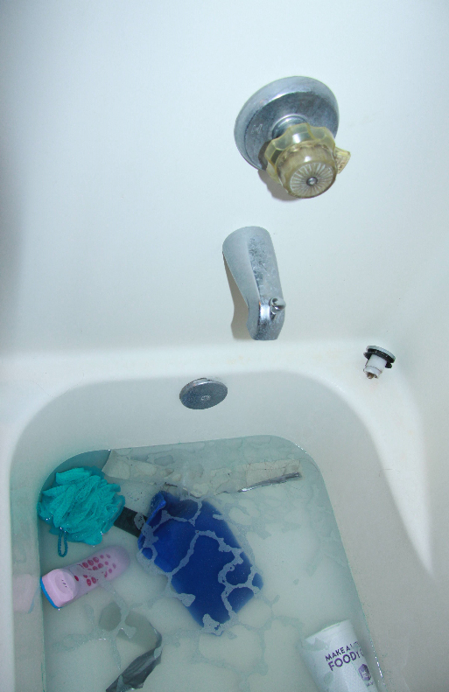
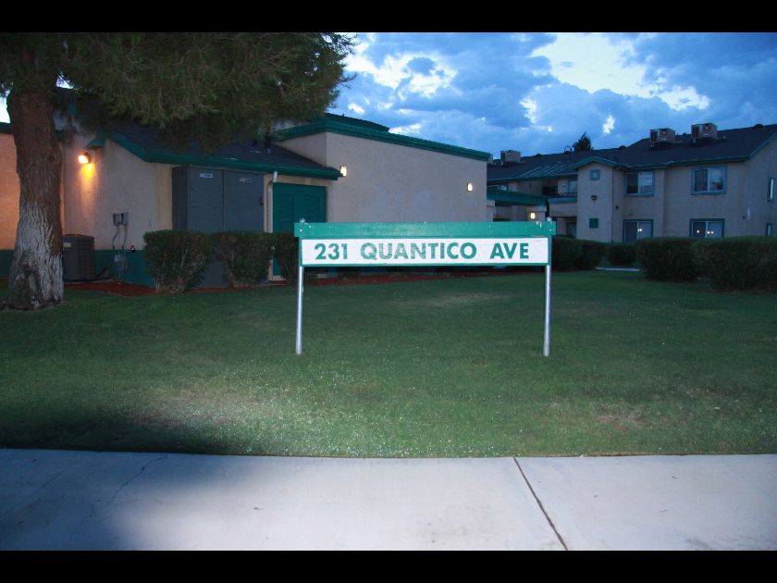
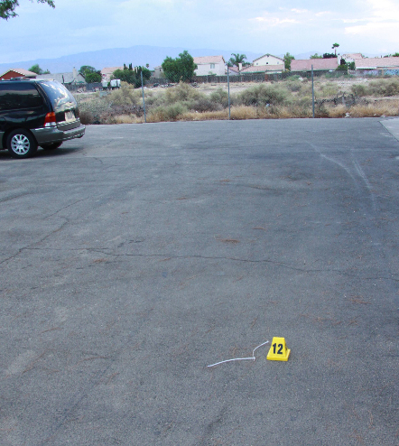
Crime scene #3
Bathtub handle
Zip tie in road

Slide 6
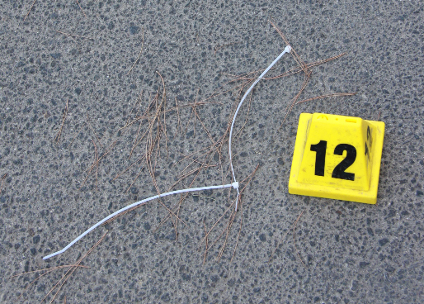
Zip tie in road
911 Call
Girl: Hi.
911: Hello, 911.
Girl: Ah yes, there’s this guy.
He has my Mom naked.
911: OK.
Girl: And he had me blind-folded.
911: OK. How old are you?
Girl: Nine.
911: Nine. Where’s your Mom at now?
Girl: What?
You’re not my Dad.
You’re not my Dad. Get off.
(Scream)

Slide 7
DNA database hit
Major contributor to DNA
of zip tie in road
Billy Ray Johnson

Slide 8
Biological evidence
Kern Regional Crime Laboratory
garments
blankets
apartment surfaces
skin
body cavities telephones
zip ties
thirty seven
swabs and cuttings
Early October 2013
low-level DNA mixtures containing 3 or 4 people

Slide 9
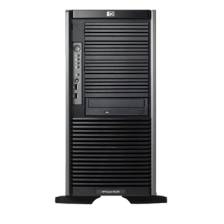

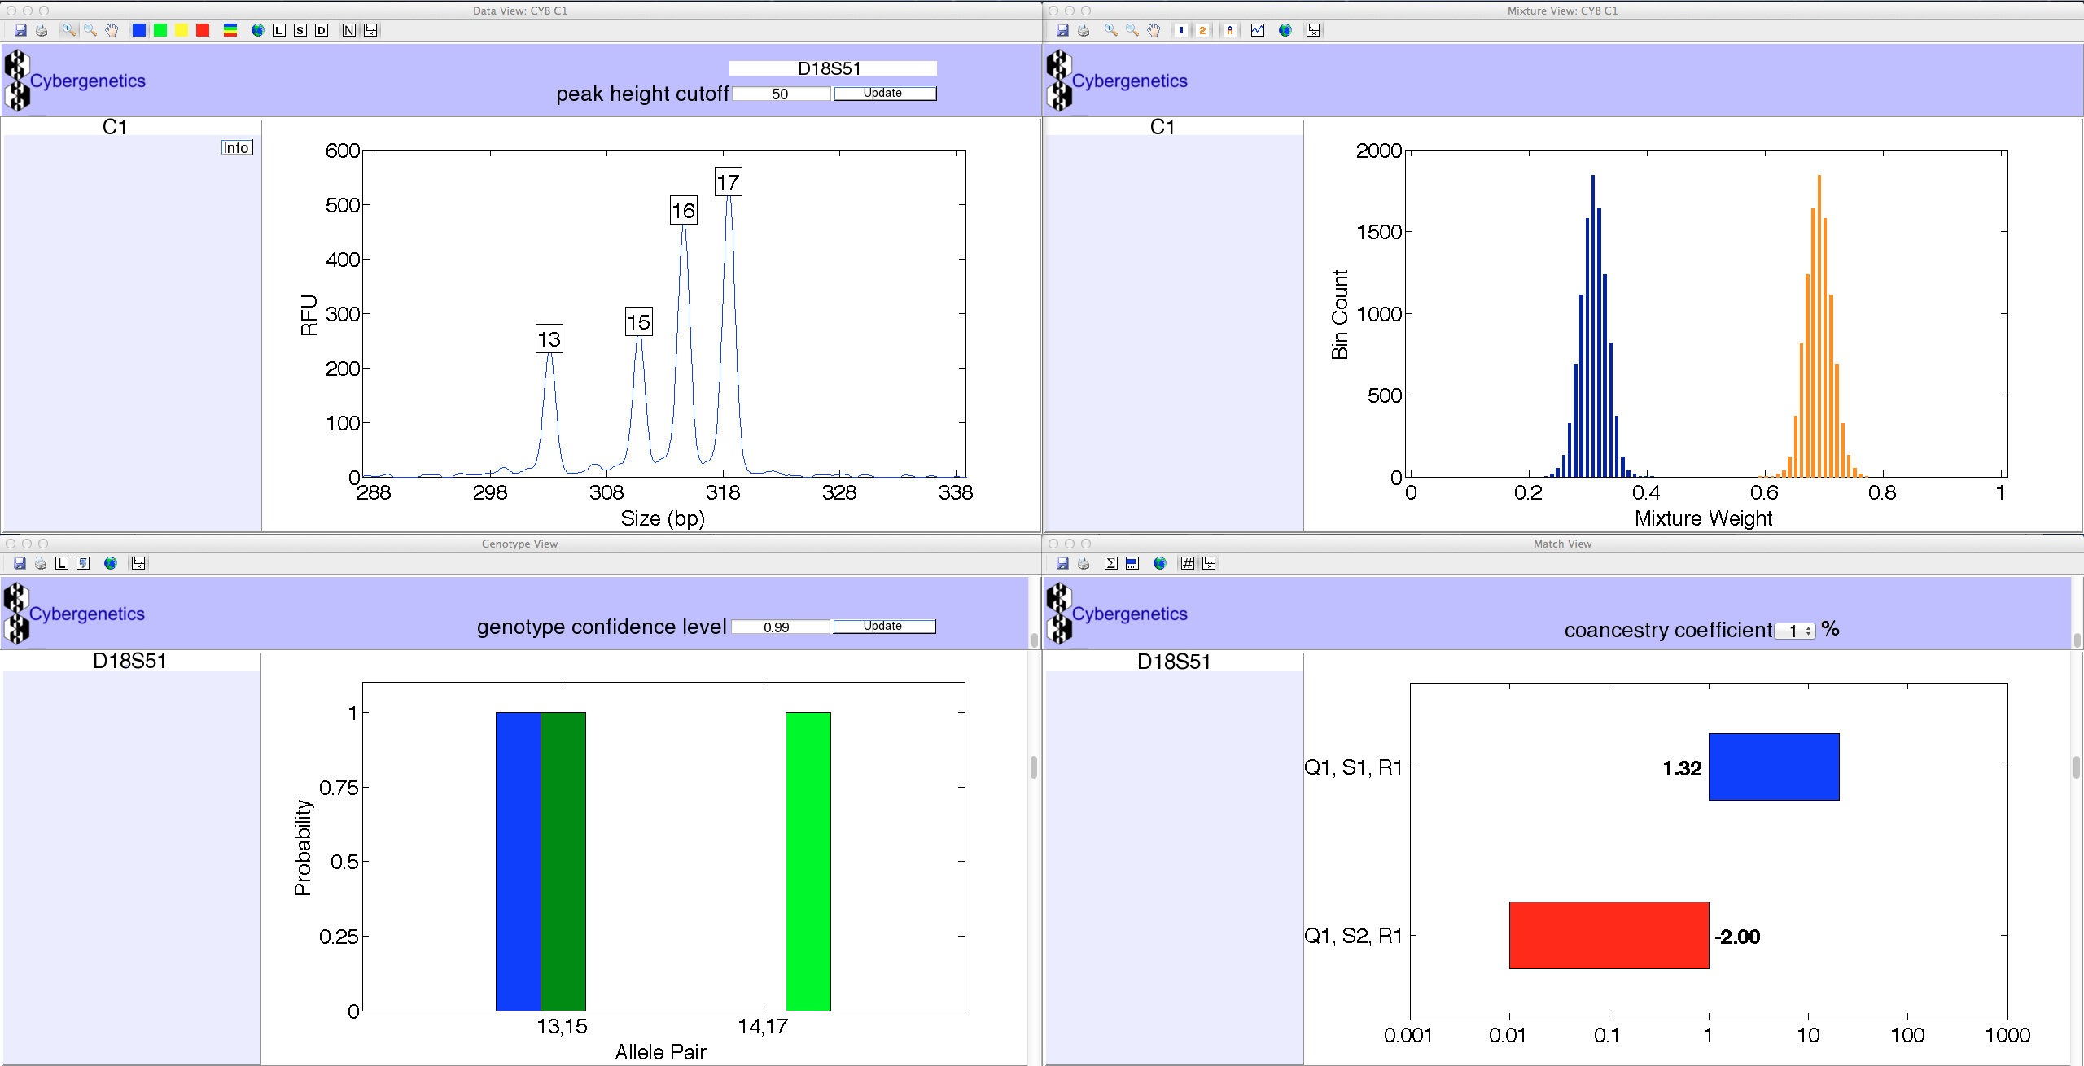
TrueAllele® Casework
ViewStation
User Client
Database
Server
Interpret/Match
Expansion
Visual User Interface
VUIer™ Software
Parallel Processing Computers

Slide 10

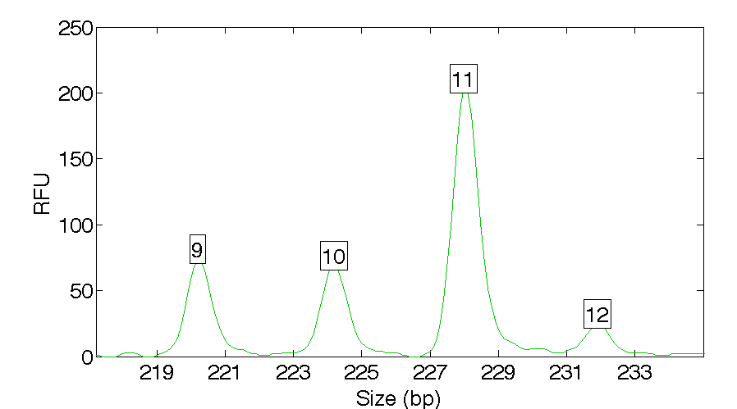
Quantitative mixture data
Receive evidence data
KRCL tested biological items, generated STR data
zip tie in road
locus D13S317

Slide 11
DNA largely inconclusive
Over threshold, peaks are labeled as allele events
All-or-none allele peaks,
each given equal status
Threshold
Under threshold, alleles vanish

Slide 12
Separate genotypes
Consider every possible genotype solution
Explain the
peak pattern
One person's allele pair
Another person's allele pair
A third person's allele pair
Better explanation has a higher likelihood

Slide 13
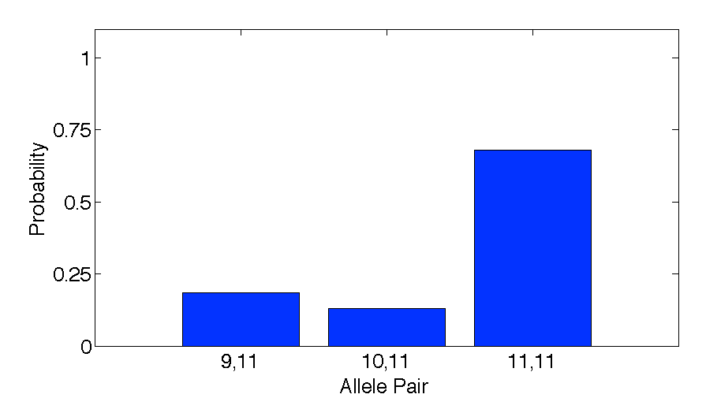
Evidence genotype
Objective genotype determined solely from the DNA data.
Never sees a comparison reference.
68%
19%
13%

Slide 14
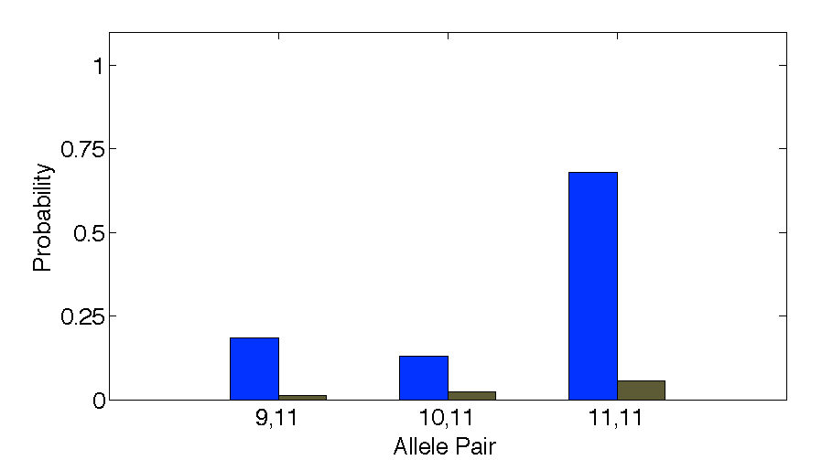
DNA match information
How much more does the suspect match the evidence
than a random person?
10x
68%
Prob(evidence match)
Prob(coincidental match)
7%

Slide 15
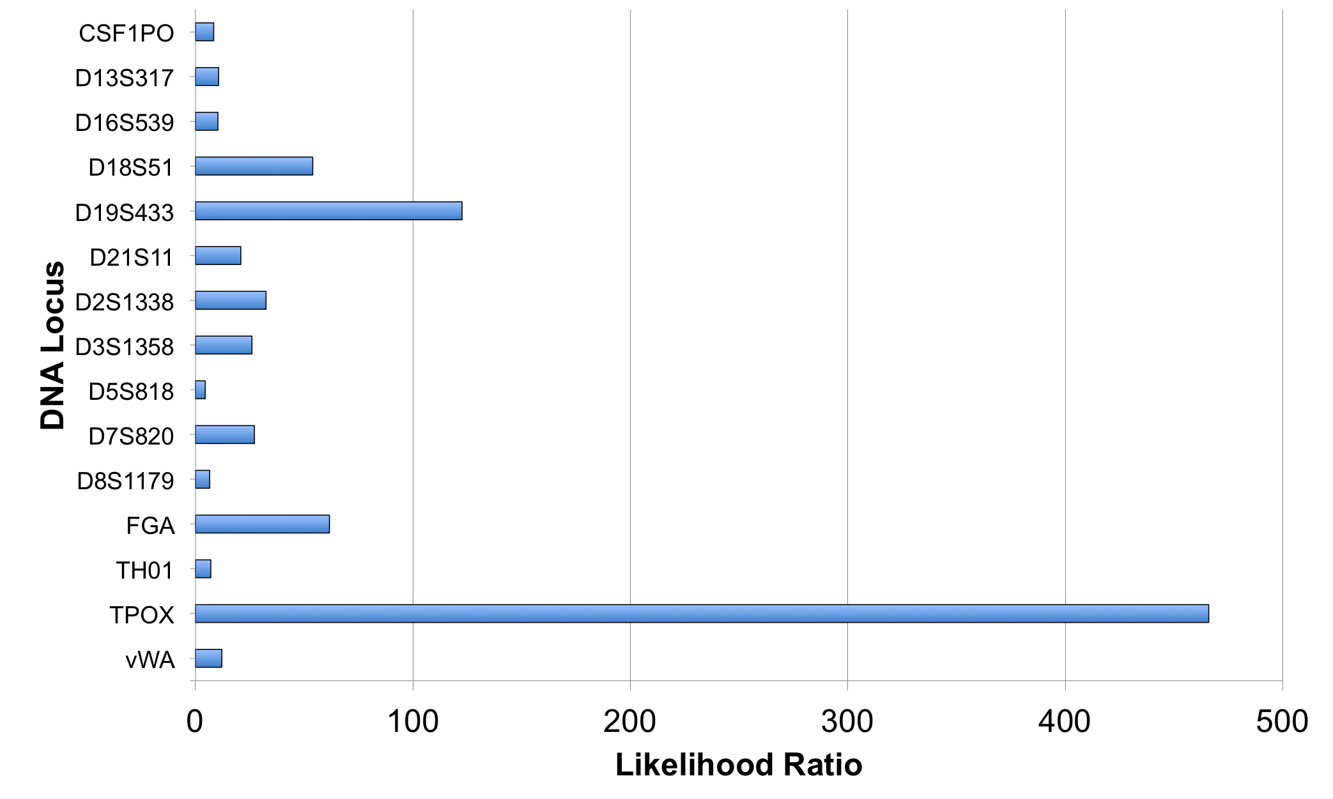
Match information at 15 loci

Slide 16
Is the suspect in the evidence?
A match between the zip tie
and Billy Ray Johnson is:
211 quintillion times more probable than
a coincidental match to an unrelated Black person
100,000,000,000,000,000,000
20 zeros after the one
10x10x10x10x10x10x10x10x10x10x
10x10x10x10x10x10x10x10x10x10
20 powers of ten

Slide 17
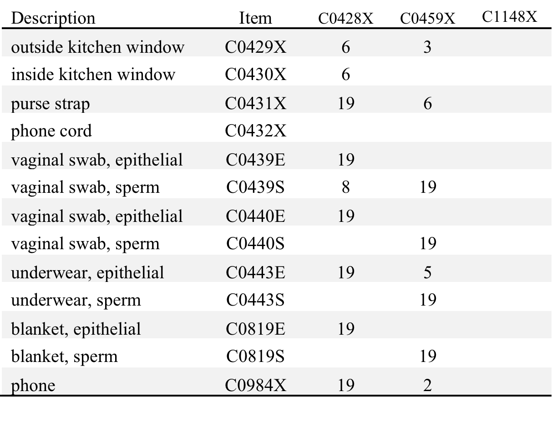
Crime scene #1 matches
Receive reference data
BRJ
2
5
Late October 2013
5

Slide 18
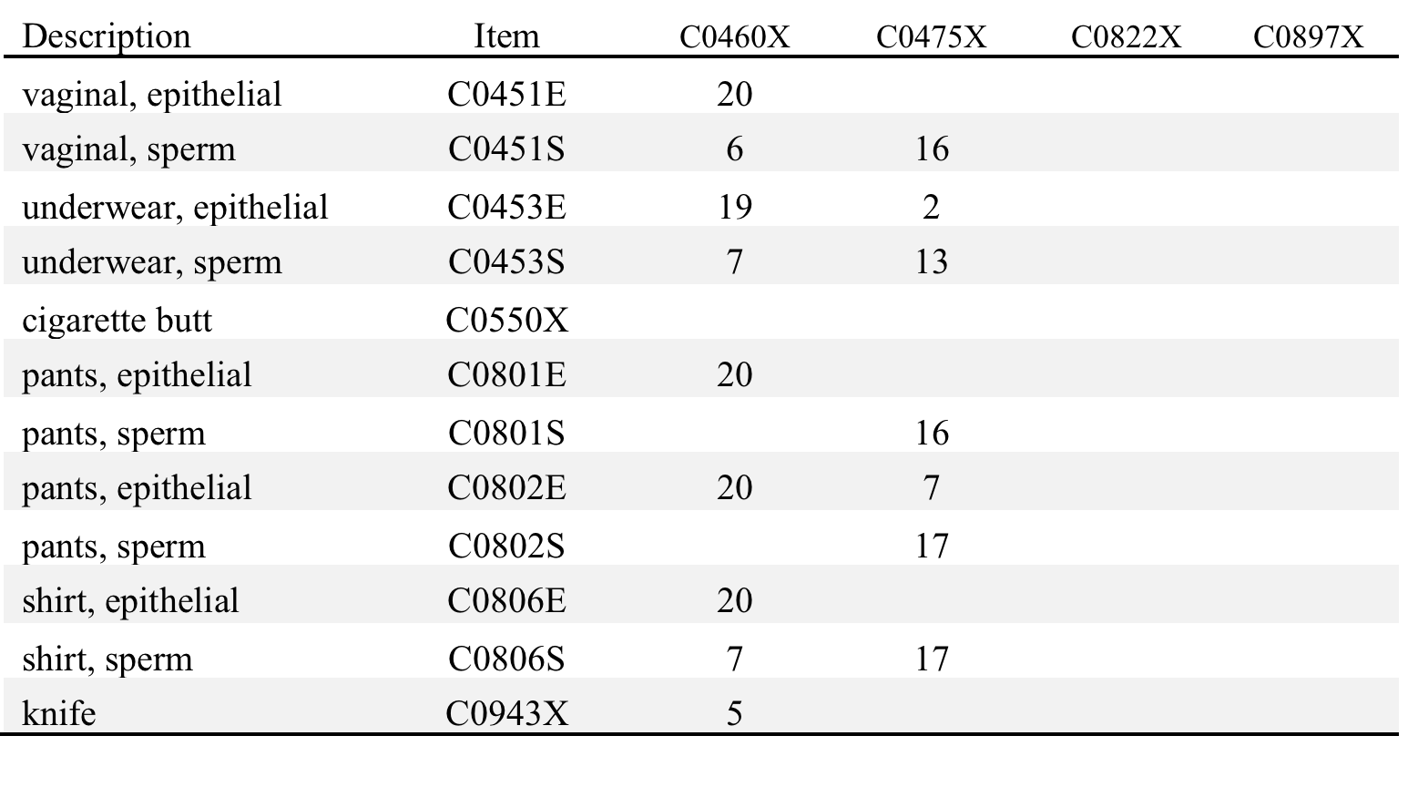
Crime scene #2 matches
BRJ
6
7
9

Slide 19
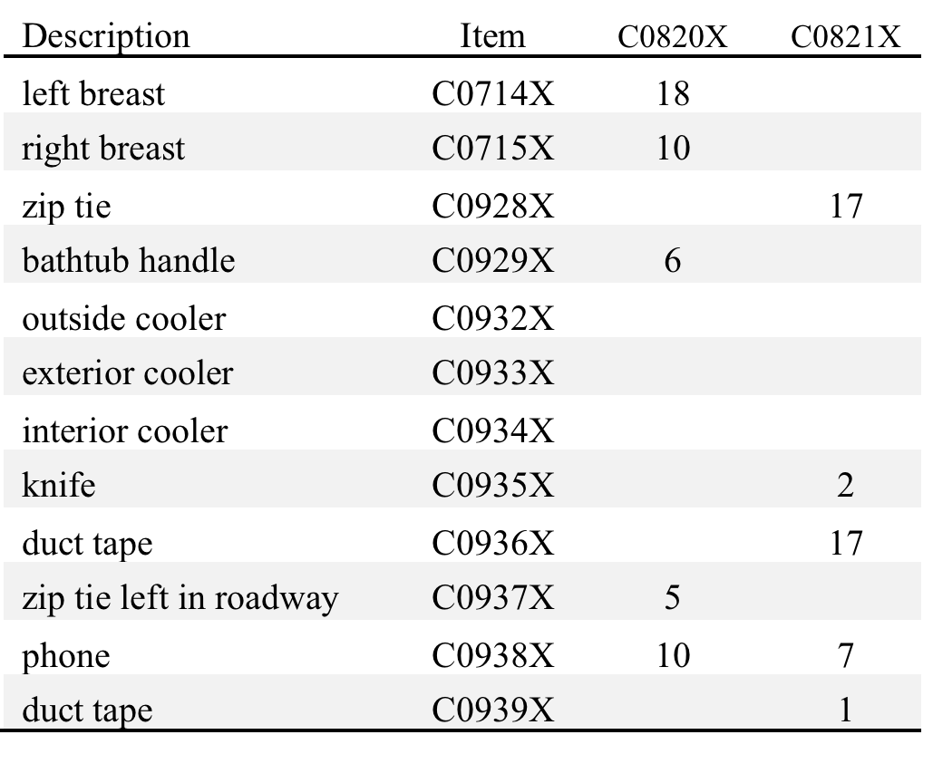
Crime scene #3 matches
BRJ
3
20

Slide 20
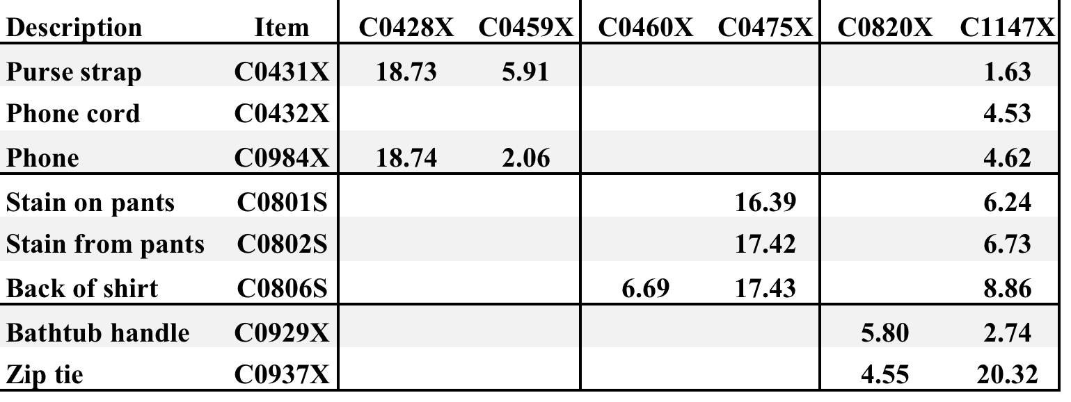
Informative DNA mixtures
8 mixture items vs. 5 victims + 1 suspect
BRJ
DNA match statistics
corroborate victim statements

Slide 21
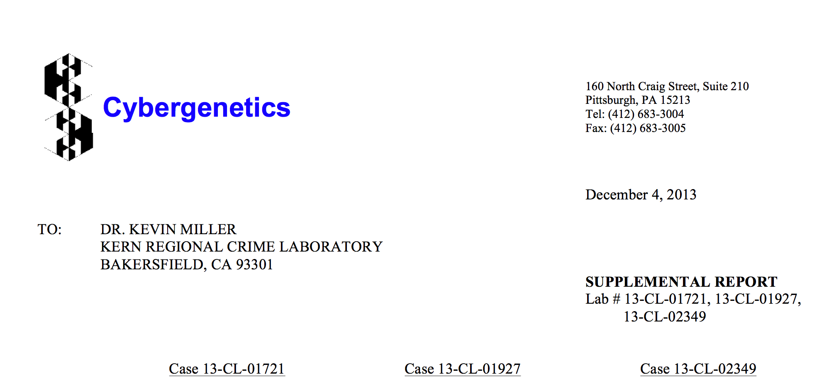

December 2013: Grand Jury
Cybergenetics TrueAllele Report
Arrest

Slide 22
March 2015: Trial
Case | Item | Description | C1147X Billy Ray Johnson
13-CL-01721 | C0431X | Purse strap | 1.63
 | C0432X | Phone cord | 4.53
 | C0984X | Phone | 4.62
13-CL-01927 | C0801S | Stain on pants | 6.24
 | C0802S | Stain from pants | 6.73
 | C0806S | Back of shirt | 8.86
13-CL-02349 | C0929X | Bathtub handle | 2.74
 | C0937X | Zip tie | 20.32

Slide 23



Validation studies

Slide 24
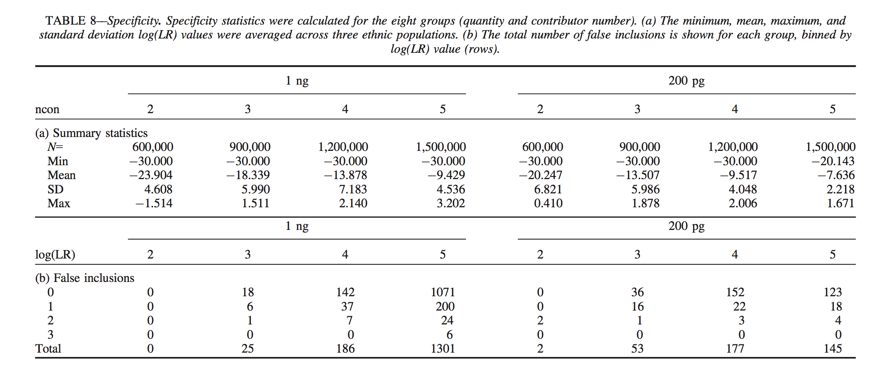
Match error rates
False positive rate in Specificity Table 8

Slide 25
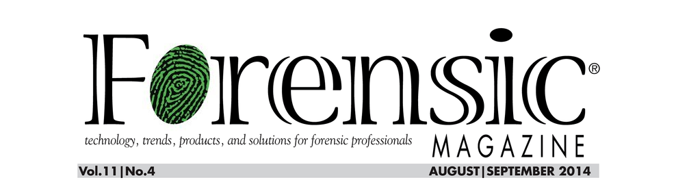
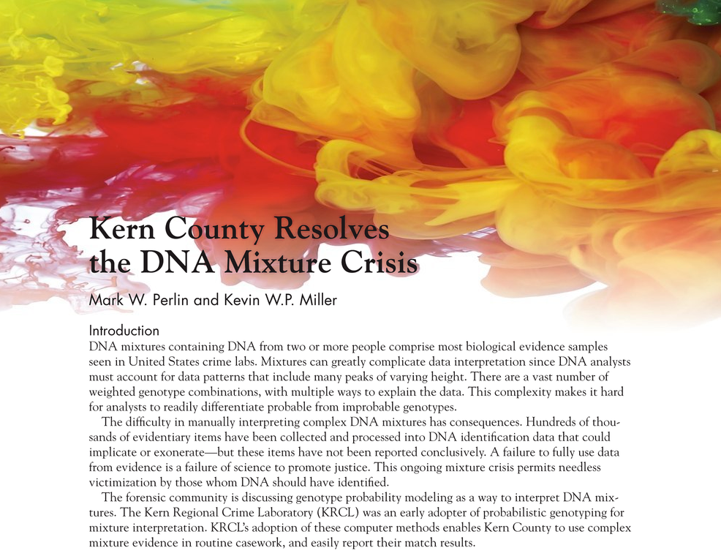
Crime lab runs TrueAllele

Slide 26
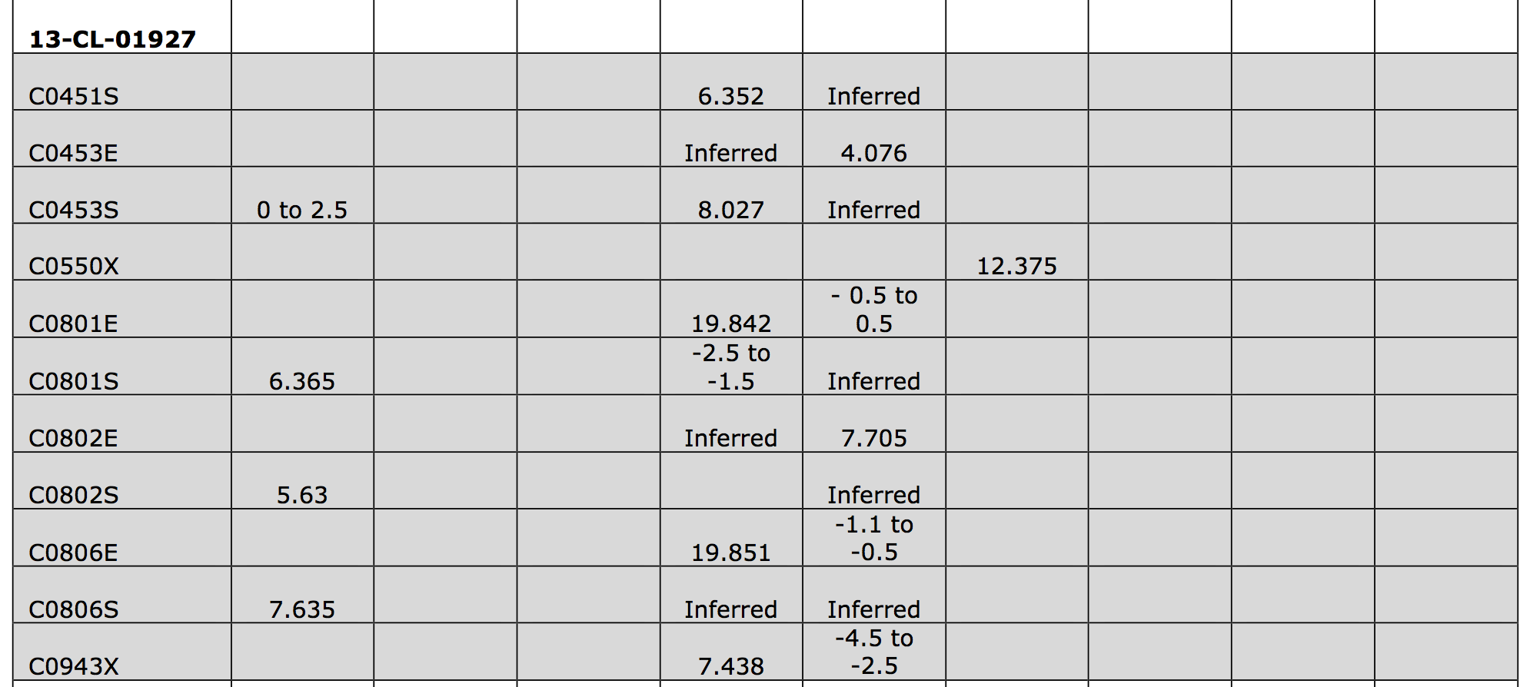
Concordant Kern lab report
Independent TrueAllele processing

Slide 27
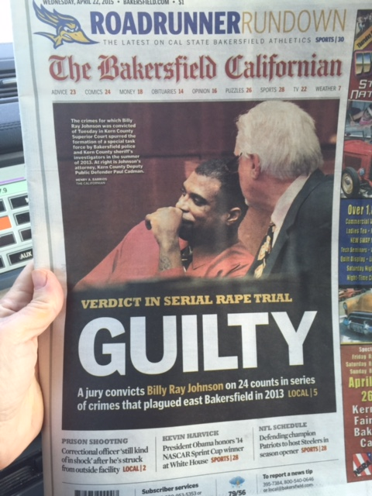
April 2015

Slide 28
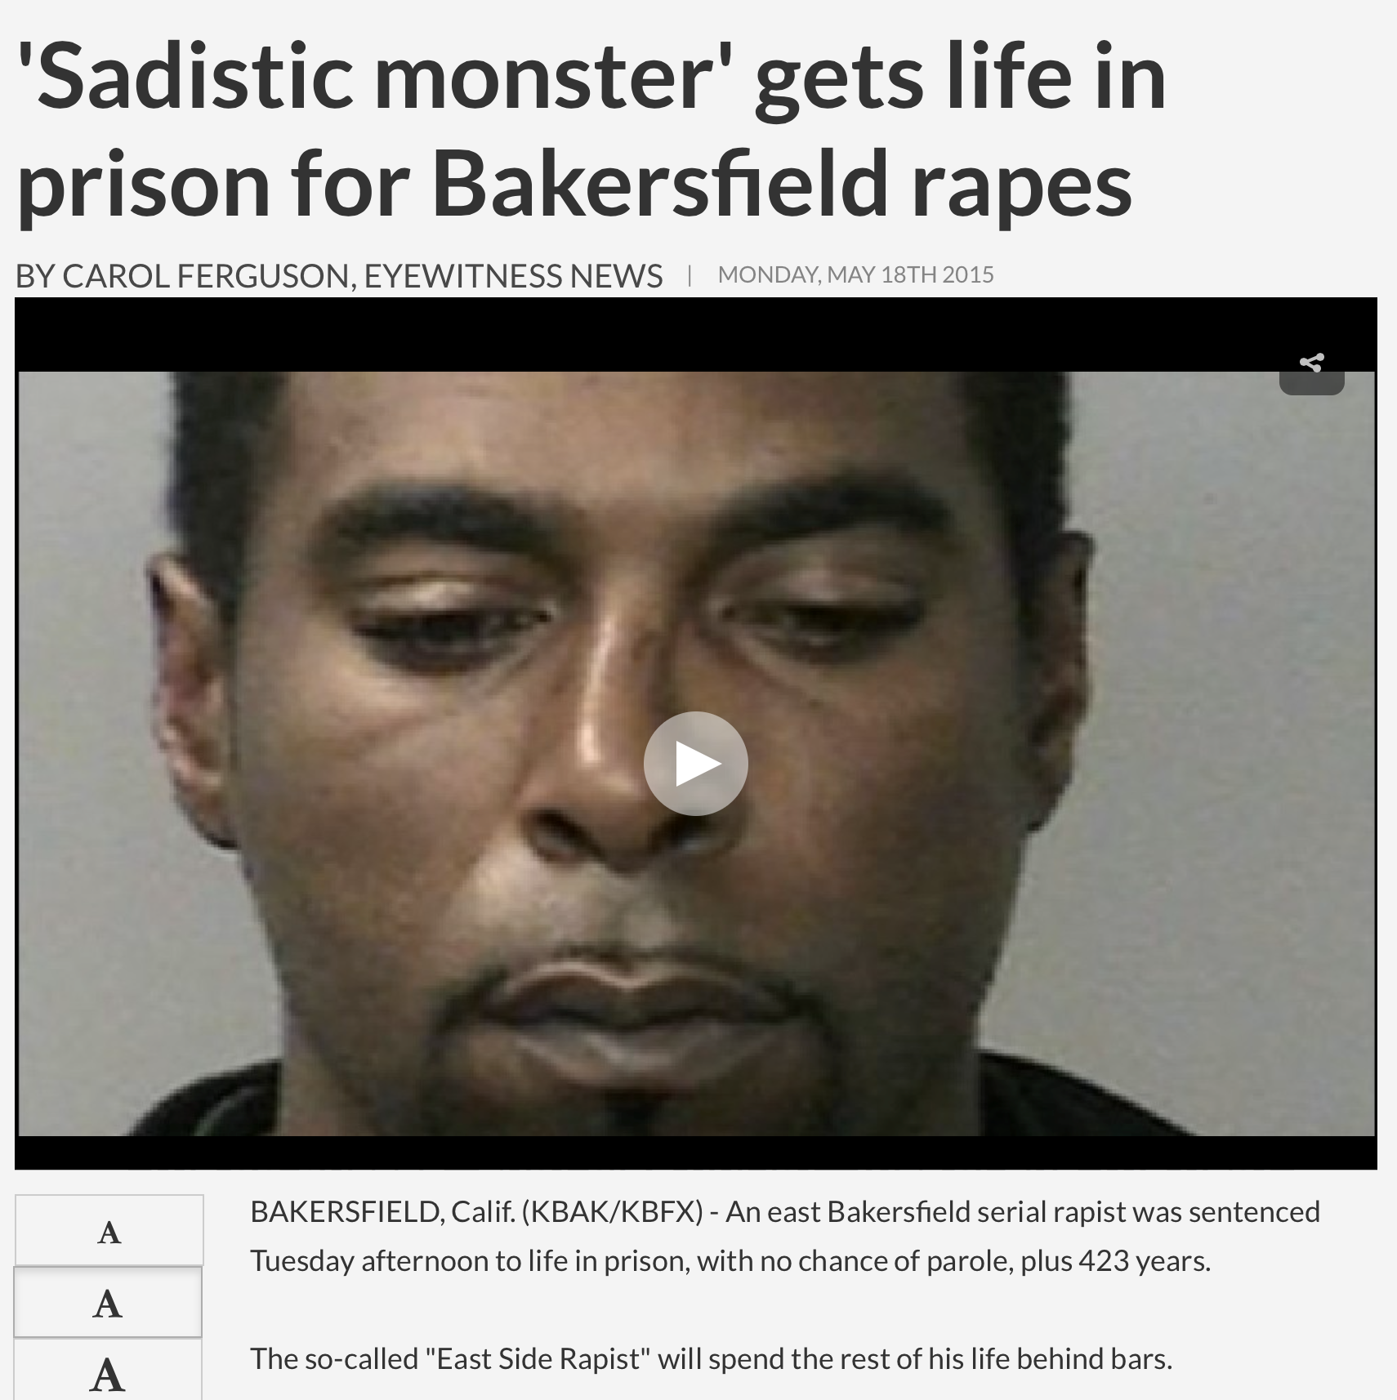
May 2015

Slide 29


More information
http://www.cybgen.com/information
• Courses
• Newsletters
• Newsroom
• Presentations
• Publications
• Webinars
http://www.youtube.com/user/TrueAllele
TrueAllele YouTube channel
perlin@cybgen.com

